Slide 1
“Heroes and Villains”
Proverbs 4:18-19

Slide 2
We know that evil exists.
We hope for an external solution to evil.
We like to identify righteousness and wickedness.

Slide 3
“Heroes and Villains”
Proverbs 4:18-19

Slide 4
Original Conditions of Creation
Plenty, not scarcity. (Genesis 1:29)
Universal peace. (Isaiah 11:6-9)
Tender relationships. (Genesis 1:19-23)
God’s good dominion. (Genesis 1:2-2:3)

Slide 5
Heroes represent God’s original intent
Villains represent sin’s curse

Slide 6
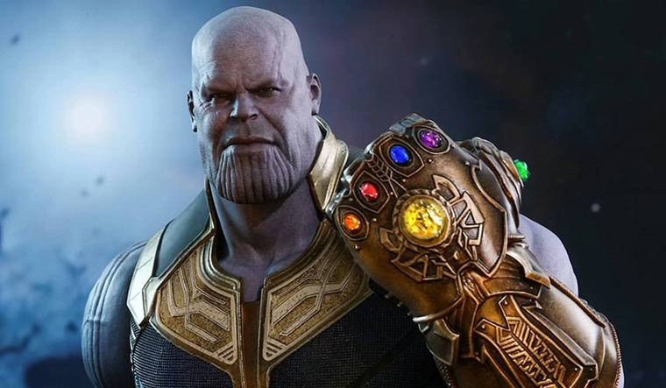
Thanos
Scarcity vs. Abundance

Slide 7
Joker
Chaos vs. Order

Slide 8
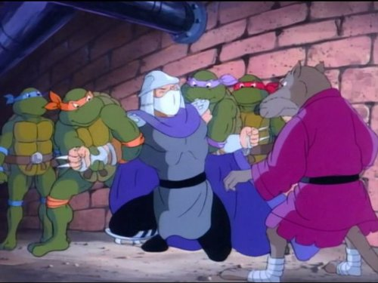
Shredder
Wicked Rule vs. Righteous Rule

Slide 9
“Heroes and Villains”
Proverbs 4:18-19

Slide 10
Proverbs 4:18-19
¹⁸ The path of the righteous is like the morning sun, shining ever brighter till the full light of day. ¹⁹ But the way of the wicked is like deep darkness; they do not know what makes them stumble.

Slide 11
TRENDS
Righteousness brings life to individual and community. Wickedness brings destruction to individual and community.
You can’t fake righteousness or wickedness.
God sees and will judge the righteous and the wicked.

Slide 12
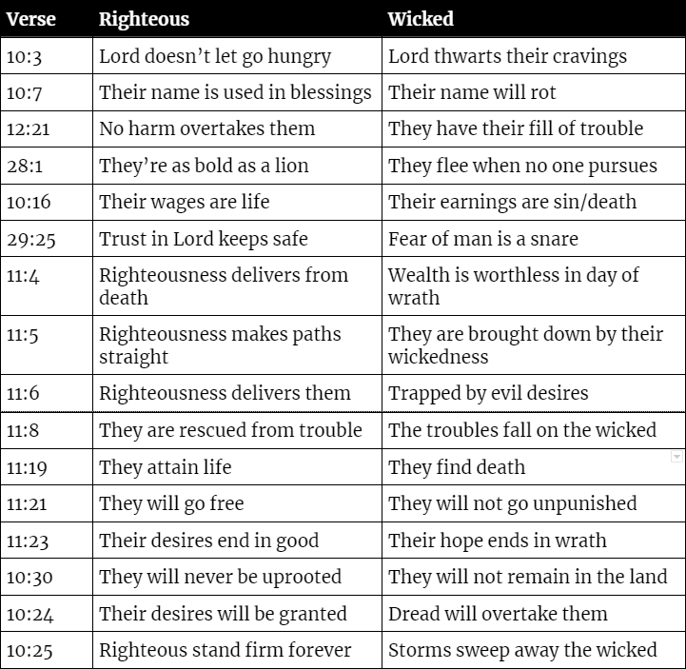
1. Impact on individual and community

Slide 13
Proverbs 5:22
²² The evil deeds of the wicked ensnare them; the cords of their sins hold them fast.

Slide 14
“Heroes and Villains”
Proverbs 4:18-19

Slide 15
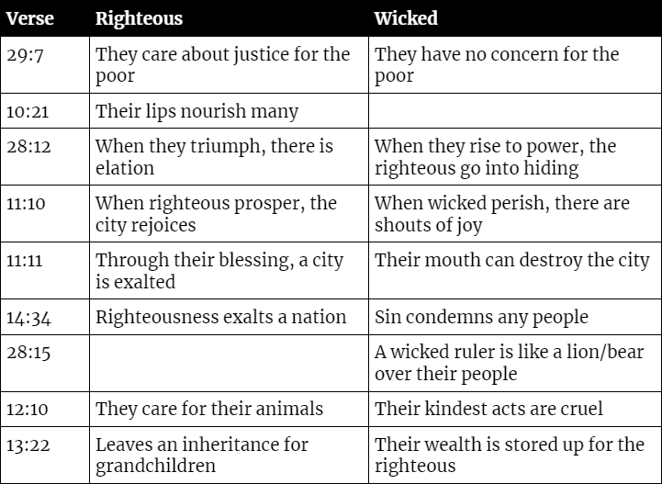
1. Impact on individual and community

Slide 16
Proverbs 27:23-27
²³ Be sure you know the condition of your flocks, give careful attention to your herds; ²⁴ for riches do not endure forever, and a crown is not secure for all generations. ²⁵ When the hay is removed and new growth appears and the grass from the hills is gathered in, ²⁶ the lambs will provide you with clothing, and the goats with the price of a field. ²⁷ You will have plenty of goats’ milk to feed your family and to nourish your female servants.

Slide 17
“Heroes and Villains”
Proverbs 4:18-19

Slide 18
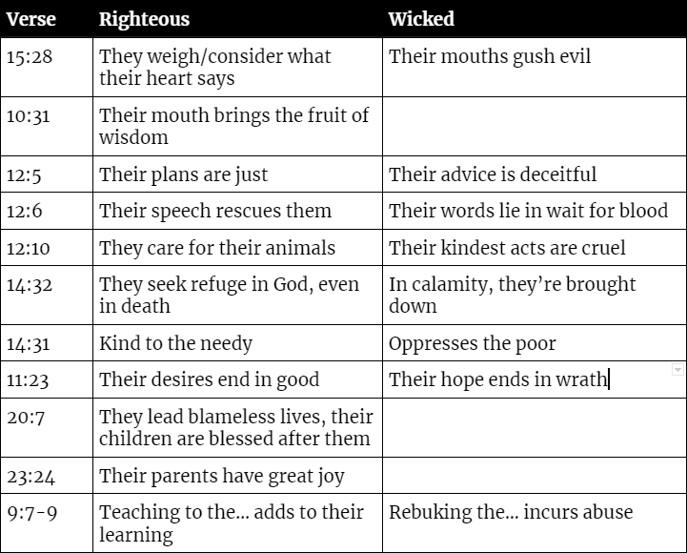
2. Can’t fake righteousness or wickedness

Slide 19
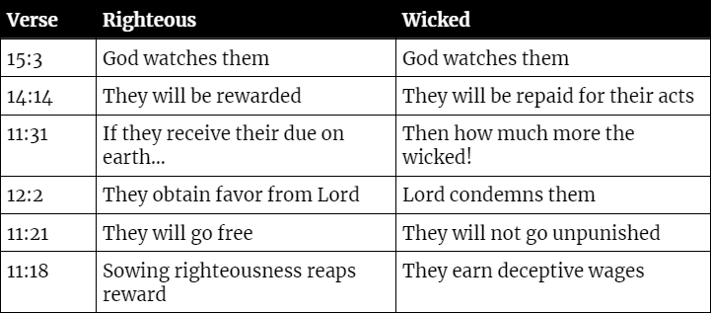
3. Righteous and wicked will be judged

Slide 20
“Heroes and Villains”
Proverbs 4:18-19

